Slide 1

Python Project Proposal
Project Title: COVIDINFO v1.0 – A Covid Information Analyzer

Slide 2
Outline
Objective
Working Procedure
Project User Interface
Expected Outcomes
Conclusion
Python Project Presentation

Slide 3
Objective
This system is developed using the general needs required by the user while it's needed to analyze COVID information. The objective of my Project "COVIDINFO" is to scrape COVID data from the internet and provide multiple functionalities. The system has very user-friendly UI/UX and anticipated that user will easily access functions of this software.
Python Project Presentation

Slide 4
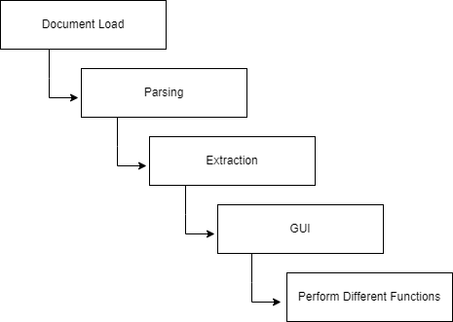
Working Procedure
Python Project Presentation

Slide 5
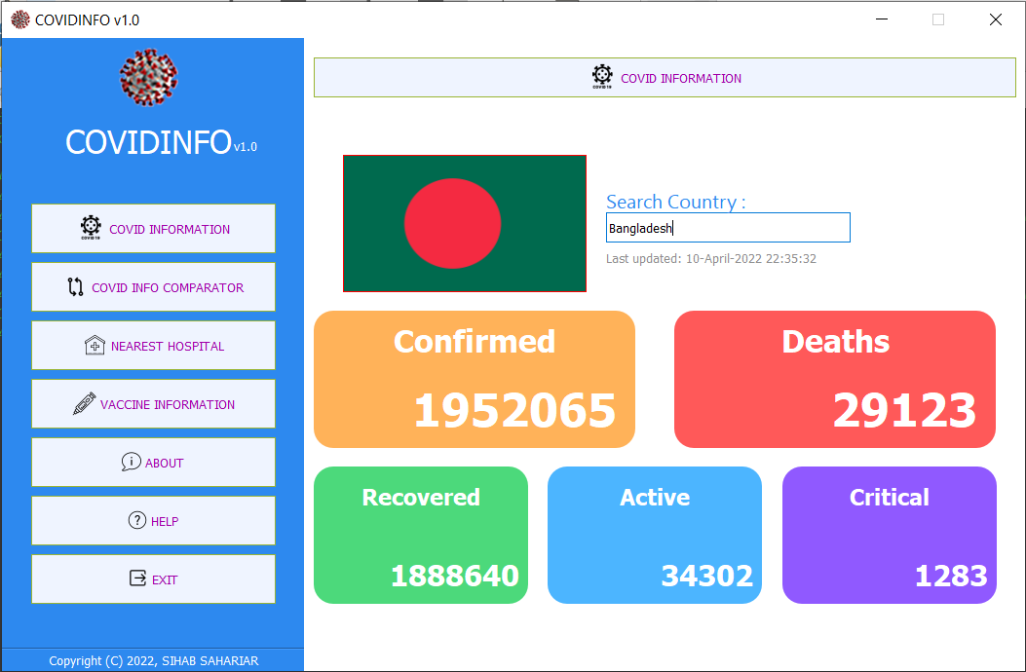
Project User Interface
Python Project Presentation

Slide 6
Expected Outcomes
We expected our outcomes are :
search() : Scrapes the COVID data from the web and shows in the GUI
compare_covid(): Compares the data of two countries about COVID and shows in the GUI
callAmbulance(): Shows the Emergency Ambulance contact number
findHospital(): Finds all the nearest Hospitals and shows in Google Map, embedded in the GUI
connect() : Checks if the internet connection has been established properly or not
Python Project Presentation

Slide 7
Conclusion
Provided Features :
1. Real time update of COVID Information.
2. Comparison of Covid Situation between two countries.
3. Information of Nearest Hospital and live location view.
4. Emergency Ambulance information.
5. Built-in Vaccine Information webpage of Surokkha
6. Simple & Interactive GUI.
7. Free & Open Source
Python Project Presentation

Slide 8
Thank You
Python Project Presentation

